Slide 1
Coursera Capstone project
Coursera IBM Data Science Certification
By,
Yogananda Srihari Prasad Gone

Slide 2
Report Content
1. Introduction Section :
⁃ The “business problem” to be solved by this project and who may be interested.
2. Data Section:
⁃ Describe Data requirements and Sources needed to solve the problem
3. Methodology section:
⁃ Main component of the report - Execute data processing, describe/discuss any
exploratory data analysis and/or inferential statistical testing performed, and/or
machine learnings used.
4. Results section:
⁃ Discussion of the results and finding of answer
5. Discussion section:
⁃ Discussion of observations noted and any recommendations
6. Conclusion section:
⁃ Answer chosen and conclusions.

Slide 3
1. Introduction
1.1 Description, Scenario, Background and Explaination of the Problem :-
Presently, I am pursuing my graduation in Computer Science and Engineering Stream and working on the areas of Data Science. I live in Hyderabad, India. I currently live within walking distance to RTC X roads and I enjoy many ammenities and venues in the area, such as various popular restaurants like Bawarchi, cafes, food shops, Pizza Shops and entertainment. I have been offered a great opportunity to work on the certain areas of Data Science at my college with my fello students. I am very excited and I want to use this opportunity to practice my learnings in Coursera in order to answer relevant questions arisen. The key question is : How can I find a convenient and enjoyable place similar to mine now in Hyderabad? Certainly, I search about that in Google but the idea is to use and apply myself the learned tools during the course. In order to make a comparison and evaluation of the rental options in RTC X roads, I must set some basis, therefore the apartment in RTC X roads must meet the following things:
Apartment must be 2 or 3 bedrooms.
Desired location is near a metro station in the RTC X roads and within 2km radius price of rent not exceed RS 15,000/- per month.
Top ammenities in the selected neighborhood shall be similar to current residence
Desirable to have venues such as coffee shops, Family restaurants, Study Halls, gym and food shops as a reference, I have included a map of venues near current residence in Hyderabad.
And also to ensure that Super markets, Schools, Study centers, Library are at wakable distance. And to ensure that there is no water problem in that particular locality.

Slide 4
1.2 Challenging problem and Problem to be resolved:
Apartment with min 2 bedrooms with monthly rent not to exceed RS 15,000/- permonth
Unit located within walking distance (2 km) from a metro station in RTC X Roads
Area with ammenities and venues similar to the ones described for current location
1.3 Interested and Enthusiast Audience:
I believe this is a relevant challenge with valid questions for anyone moving to other large cities in India like Hyderabad, Delhi, Mumbai etc. The same methodology can be applied in accordance to demands as applicable. This case is also applicable for anyone interested in exploring starting or locating a new business in any city. Lastly, it can also serve as a good practical exercise to develop Data Science skills. So Interested Audience can think about it and may show their intrests accordingly. Those people are highly appreciated :).

Slide 5
2. Data
The Description of the data and its sources that will be used to solve the problem are as follows:
List of Boroughs and neighborhoods of RTC X Roads with their geodata (lattitude and longitude)
List of Hyderabad metro stations in RTC X Roads with their address location
List of apartments for rent in RTC X Roads area with their addresses and price
Preferably, a list of apartment for rent with additional information, such as price, address, area etc
Venues for each RTC X Roads neighborhood ( than can be clustered)
Venues for subway metro stations, as needed
2.1 Data of Current Situation
Currently reside in the neighborhood of 'RTC X Roads' in Hyderabad. I use Foursquare to identify the venues around the area of residence which are then shown in the Hyderabad map shown in methodology and execution in section 3.0 . It serves as a reference for comparison with the desired future location in RTC X Roads

Slide 6
2.2 Data Required to resolve the problem
In order to make a good choice of a similar apartment in RTC X Roads, the following data is required: List/Information on neighborhoods form RTC X Roads with their Geodata ( lattitude and longitude. List/Information about the nearby metro stations in RTC X Roads with geodata. Listed apartments for rent in RTC X Roads area with descriptions ( how many beds, price, location, address) Venues and ammenities in the RTC X Roads neighborhoods (e.g. top 10) 2.3 sources and manipulation The list of RTC X Roads neighborhoods is worked out during LAb exercise during the course.
List of Hyderabad Metro Stations :- https://en.wikipedia.org/wiki/List_of_Hyderabad_Metro_stations
Google Map view for the above stations :- https://www.google.com/maps/search/hyderabad+metro+stations/@17.4050226,78.4593429,13z/data=!3m1!4b1
Property Rates & Price Trends in Hyderabad - 2020 :- https://www.makaan.com/price-trends/property-rates-for-buy-in-hyderabad
A csv file was created which will be read in order to create a dataframe and its mapping. The csv file 'roads_data.csv' has the following below data structure. The file will be directly read to the Jupyter Notebook for convenience and space savings. The clustering of neighborhoods and mapping will be shown however. An algorithm was used to determine the geodata from Nominatim.
With the use of geolocator = Nominatim() , it was possible to determine the latitude and longiude for the metro locations as well as for the geodata for each rental place listed. The loop algorithms used are shown in the execution of data in section 3.0 "Great_circle" function from geolocator was used to calculate distances between two points , as in the case to calculate average rent price for units around each subway station and at 2 km radius. Foursquare is used to find the avenues at RTC X Roads neighborhoods in general and a cluster is created to later be able to search for the venues depending of the location shown.

Slide 7
2.3 Data sources and data manipulation:
The data will be used as follows: Use Foursquare and geopy data to map top 10 venues for all RTC X Roads neighborhoods and clustered in groups ( as per Course LAB) Use foursquare and geopy data to map the location of metro stations , separately and on top of the above clustered map in order to be able to identify the venues and ammenities near each metro station, or explore each location separately Use Foursquare and geopy data to map the location of rental places, in some form, linked to the locations. create a map that depicts, for instance, the average rental price per square ft, around a radious of 1.0 mile (2 km) around each metro station - or a similar metrics. I will be able to quickly point to the popups to know the relative price per area. Addresses from rental locations will be converted to geodata( lat, long) using Geopy-distance and Nominatim. Data will be searched in open data sources if available, from real estate sites if open to reading, libraries or other government agencies such as LIC.
Mapping of the data is done as follows :-
The following maps were created to facilitate the analysis and the choice of the palace to live. RTC X Roads map of Neighborhoods RTC X Roads metro locations RTC X Roads map of places for rent RTC X Roads map of clustered venues and neighborhoods Combined maps of RTC X Roads rent places with subway locations Combined maps of RTC X Roads rent places with desired locations and venues clusters

Slide 8
3. Methodology
This section represents the main component of the report where the data is gathered, prepared for analysis. The tools described are used here and the Notebook cells indicates the execution of steps.
The analysis and the strategy
The strategy is based on mapping the above described data in section 2.0, in order to facilitate the choice of at least two candidate places for rent.
The choice is made based on the demands imposed : location near a metro station, rental price and similar venues to Hyderabad.
This visual approach and maps with popups labels allow quick identification of location, price and feature, thus making the selection very easy.

Slide 9
The processing of these DATA and its mapping will allow to answer the key questions to make a decision:
what is the cost of available rental places that meet the demands?
what is the cost of rent around a mile radius from each metro station?
what is the area of RTC X Roads with best rental pricing that meets criteria established?
What is the distance from work place and the tentative future rental home?
What are the venues of the two best places to live? How the prices compare?
How venues distribute among RTC X Roads neighborhoods and around metro stations?
Are there tradeoffs between size and price and location?
Any other interesting statistical data findings of the real estate and overall data.

Slide 10
Tools :-
Web-scraping of sites is used to consolidate data-frame information which was
saved as csv files for convenience and to simply the report. Geodata was obtained by coding a program to use Nominatim to get latitude and longitude of subway stations and also for each of (144 units) the apartments for rent listed.
Geopy_distance and Nominatim were used to establish relative distances.
Seaborn graphic was used for general statistics on rental data.
Maps with popups labels allow quick identification of location, price and feature, thus making the selection very easy.

Slide 11
4. Execution and Results

Slide 12
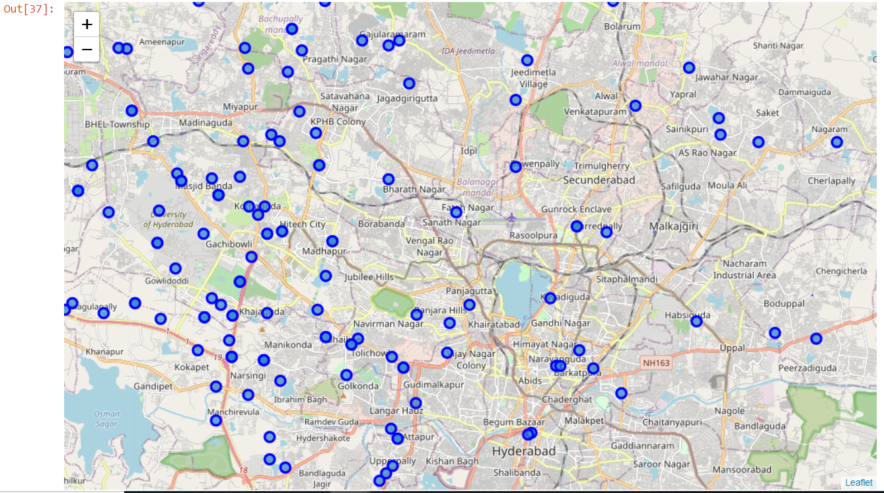
Current residence Neighborhood in Hyderabad

Slide 13
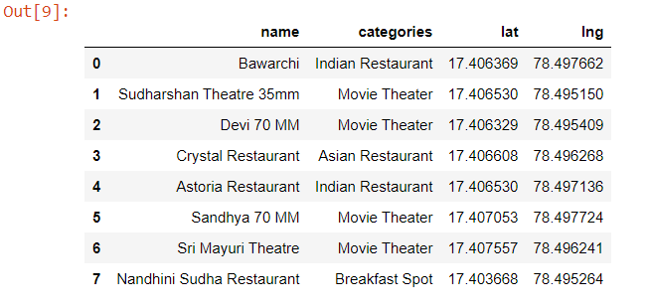
Venues around Neighbourhood :-

Slide 14
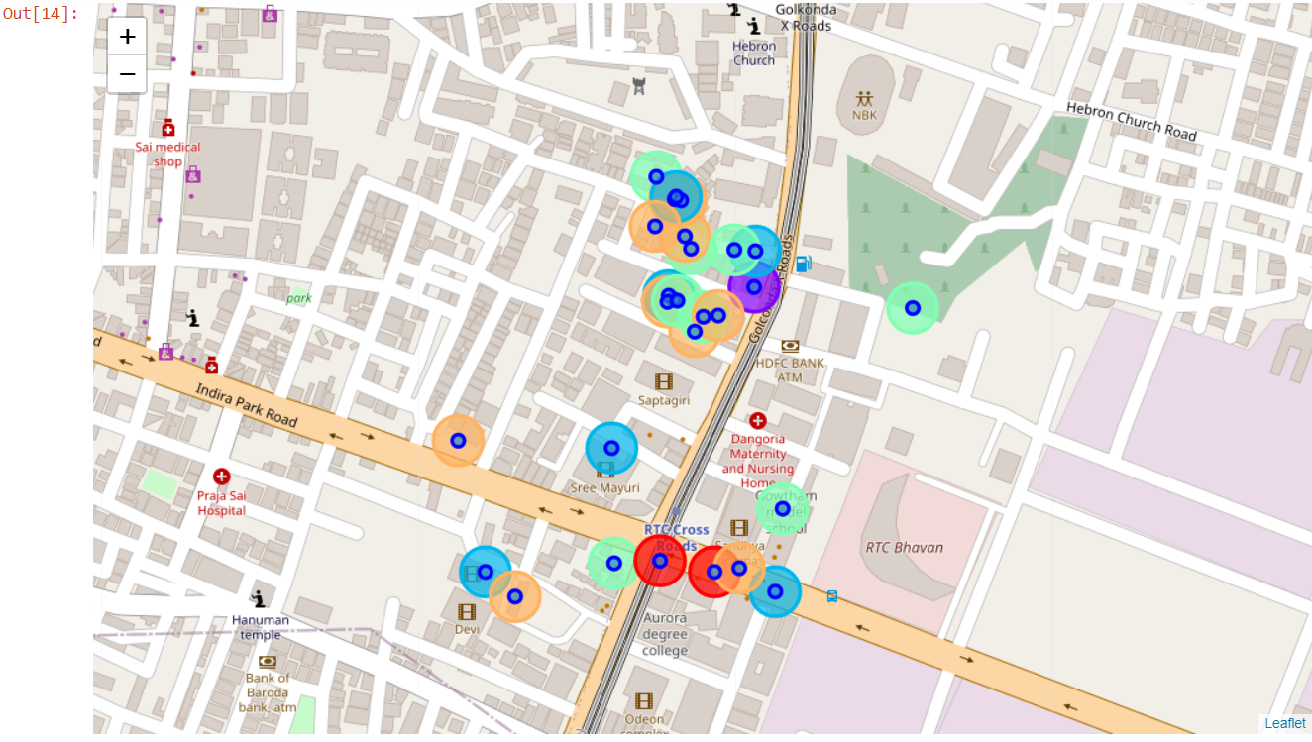
RTC X Roads, Hyderabad Map - Neighborhoods and Cluster of Venues :-

Slide 15
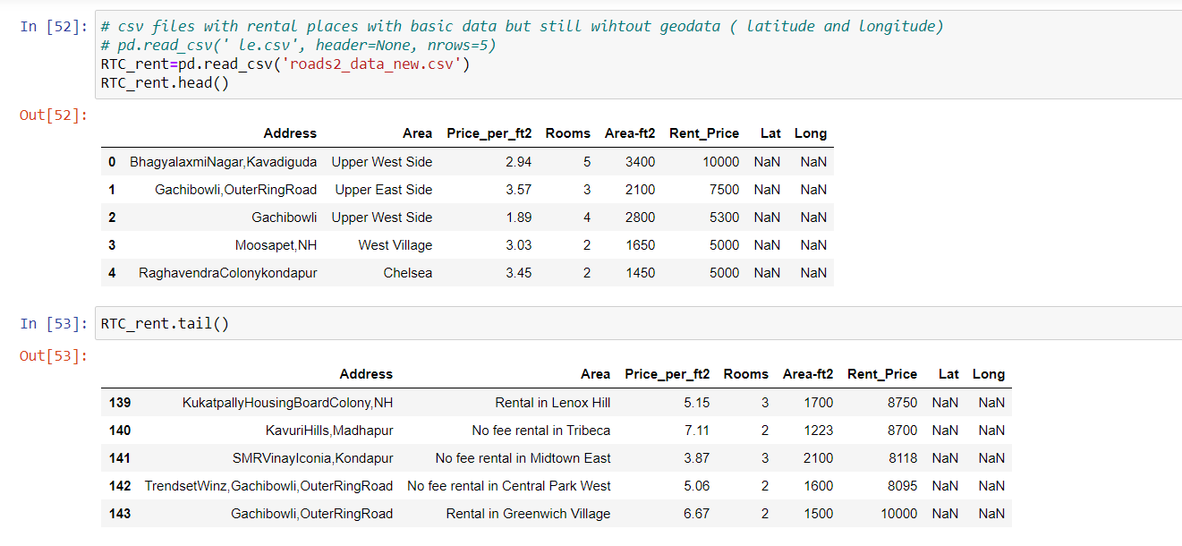
GeoData Hyderabad appartments for rent :-

Slide 16
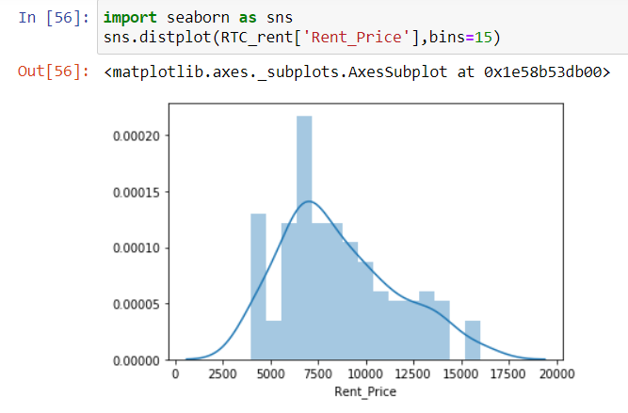
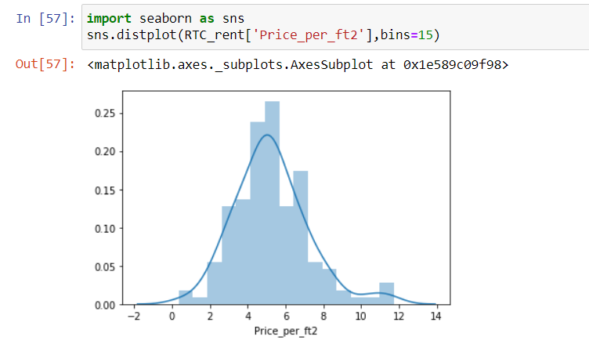
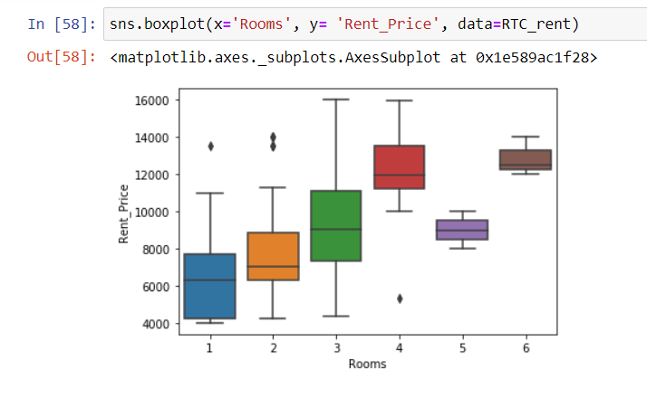
Rental Price Statistics of Appartments :-
Budget 15000/month is around the mean

Slide 17
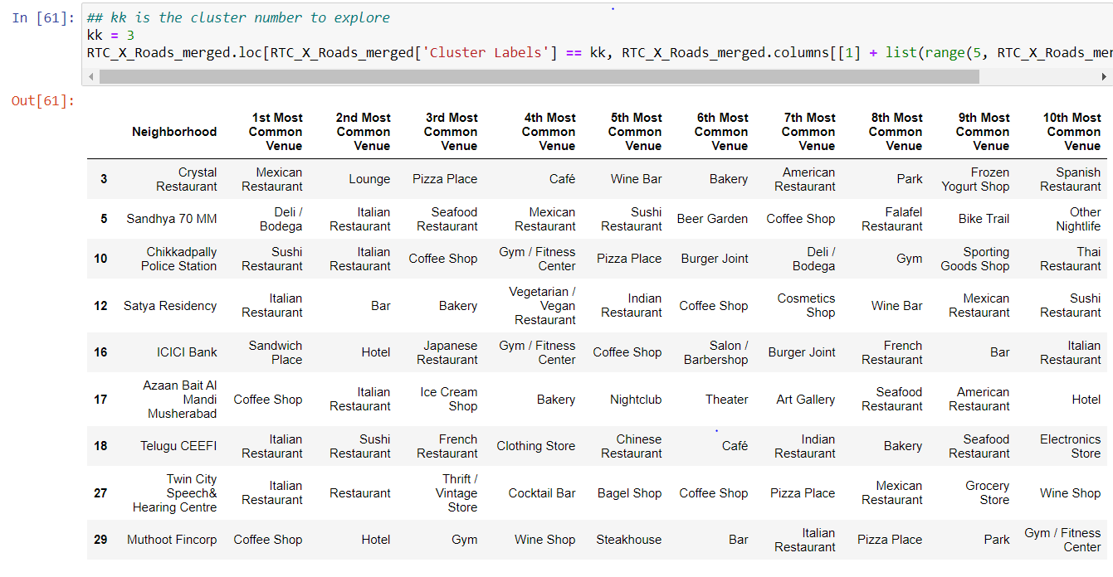
Venues of cluster 3

Slide 18
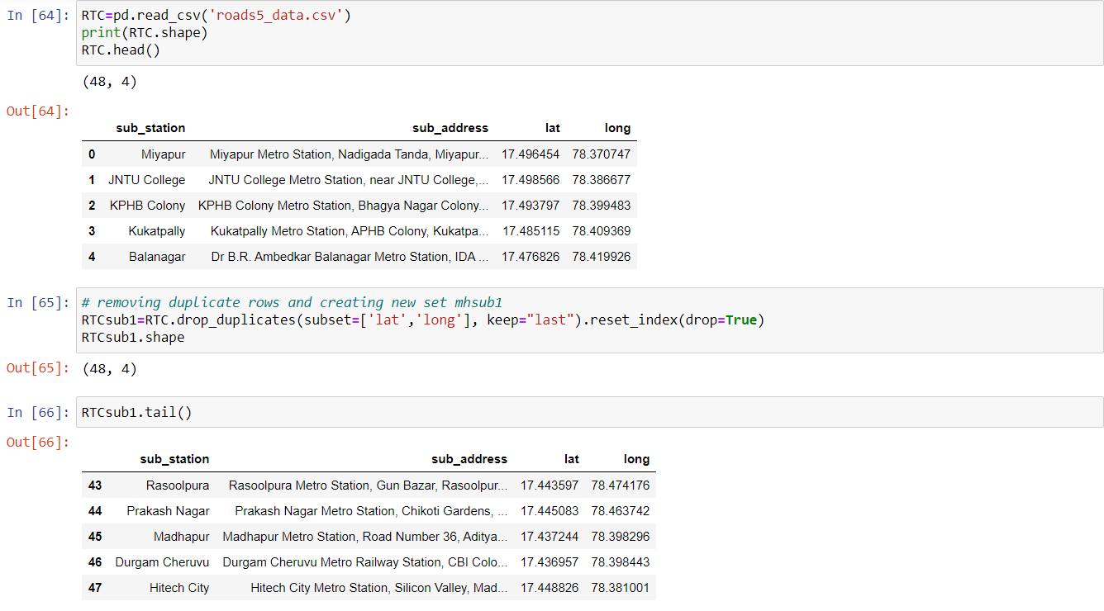
Hyderabad Metro Stations geodata

Slide 19
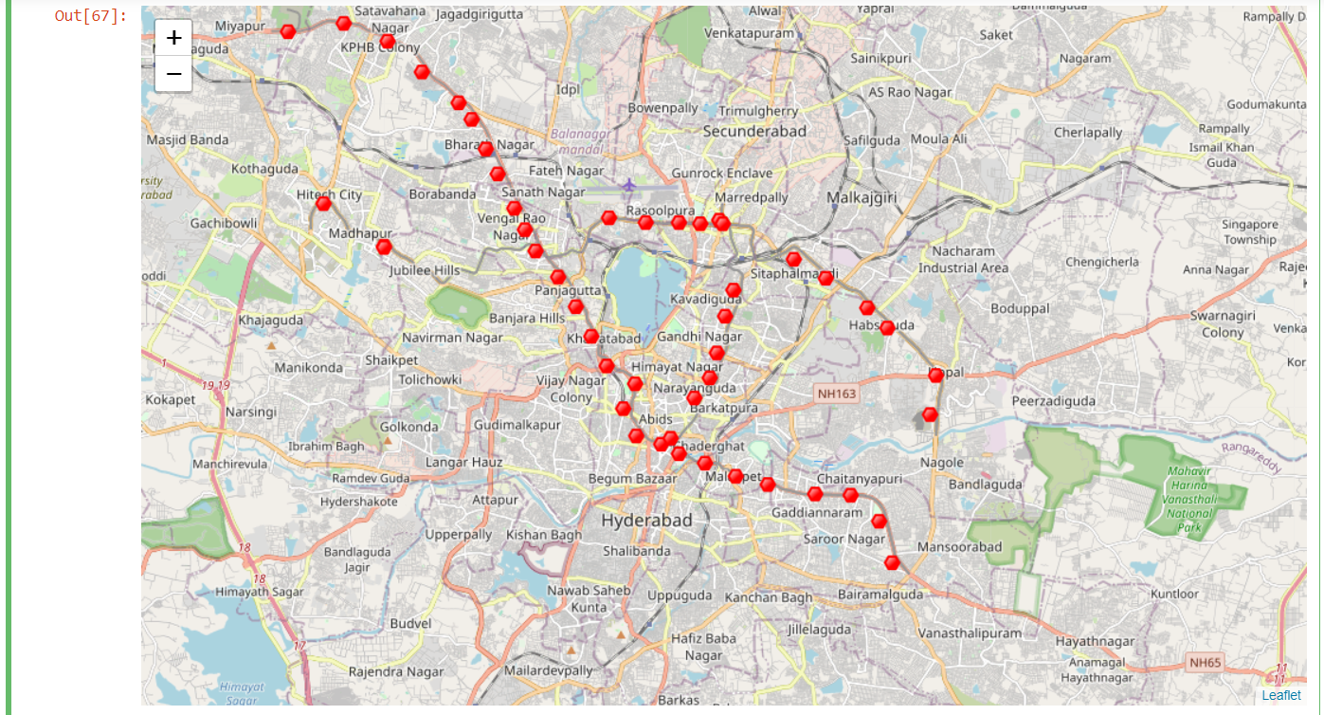
MAP of Hyderabad showing the location of subway stations :-

Slide 20
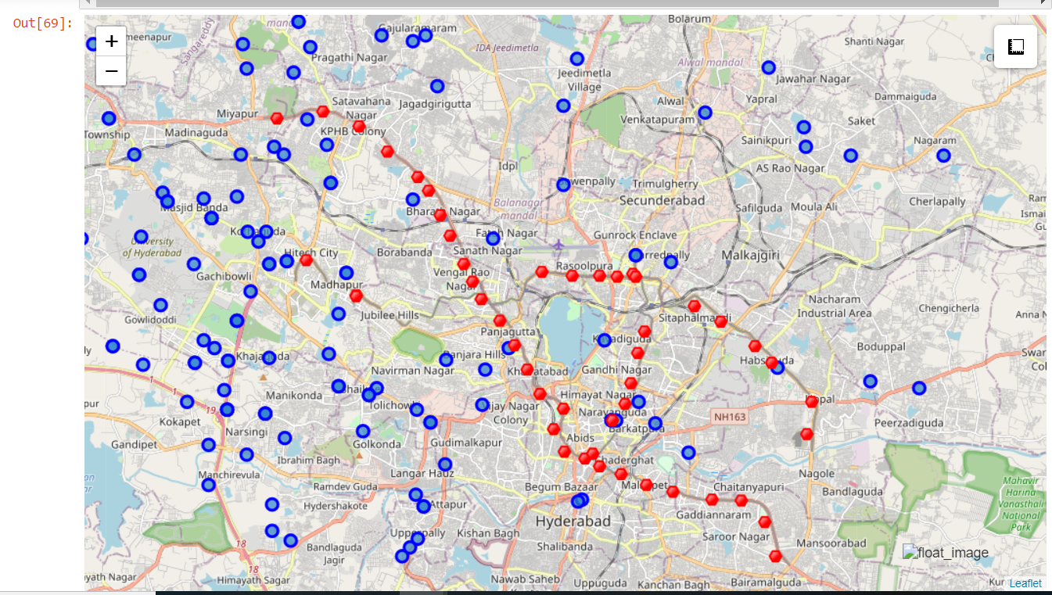
Appartments for rent (blue color) and Metro Stations (red color)

Slide 21
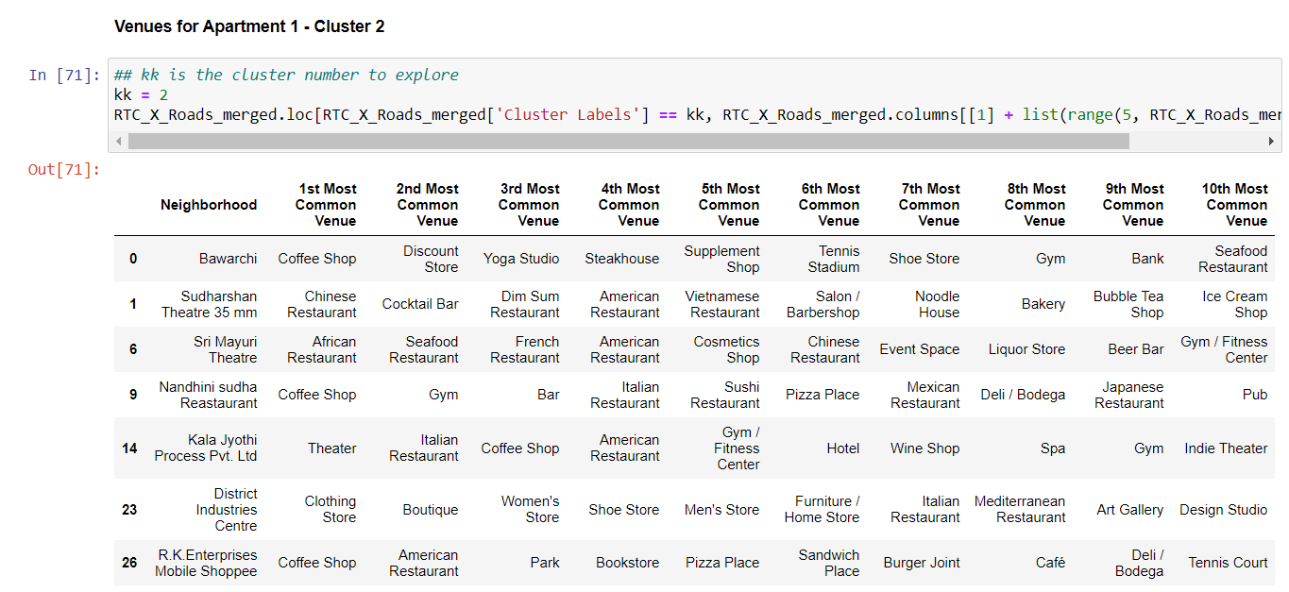
Select the apartment for rent
Venues in Cluster 2

Slide 22
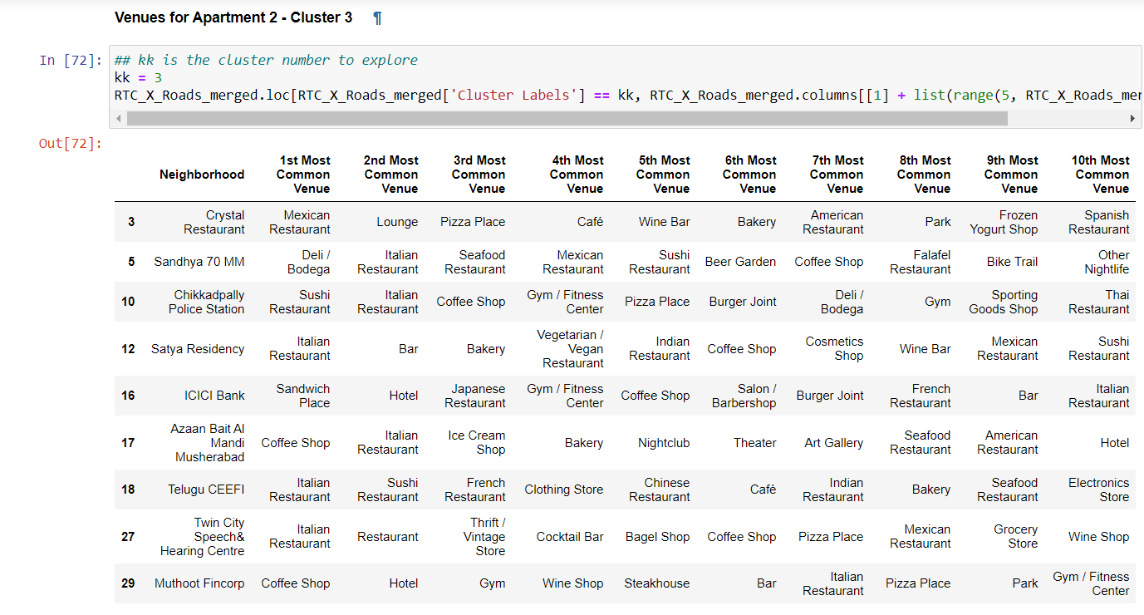
Venues in Cluster 3

Slide 23
Apartment Selection :-
Using the "one map" above, I was able to explore all possibilities since the popups provide the information needed for a good decision.
Apartment 1 rent cost is 15,000 slightly above the budget. Apt 1 is located 400 meters from subway station. One can walk to work place and use subway for other places aroung. Venues for this apt are as of Cluster 2 and it is located in a fine district in the East side of RTC_X_Roads.
Apartment 2 rent cost is 12,000, just under the budget. Apt 2 is located 60 meters from subway station but one will have to ride the subway daily to work , possibly 40-60 min ride. Venues for this apt are as of Cluster 3. Based on current Hyderabad venues, I feel that Cluster 2 type of venues is a closer resemblance to the current place. That means that APARTMENT 1 is a better choice since the extra monthly rent is worth the conveniences it provides

Slide 24
5. Discussion
In general, I am positively impressed with the overall organization, content and lab works presented during the Coursera IBM Certification Course
I feel this Capstone project presented me a great opportunity to practice and apply the Data Science tools and methodologies learned.
I have created a good project that I can present as an example to show my potential.
I feel I have acquired a good starting point to become a professional Data Scientist and I will continue exploring to creating examples of practical cases.

Slide 25
6. Conclusion
I feel rewarded with the efforts, time and money spent. I believe this course with all the topics covered is well worthy of appreciation.
This project has shown me a practical application to resolve a real situation that has impacting personal and financial impact using Data Science tools.
The mapping with Folium is a very powerful technique to consolidate information and make the analysis and decision thoroughly and with confidence. I would recommend for use in similar situations.
One must keep abreast of new tools for DS that continue to appear for application in several business fields

Slide 26
Thank You Very Much...

